Slide 1
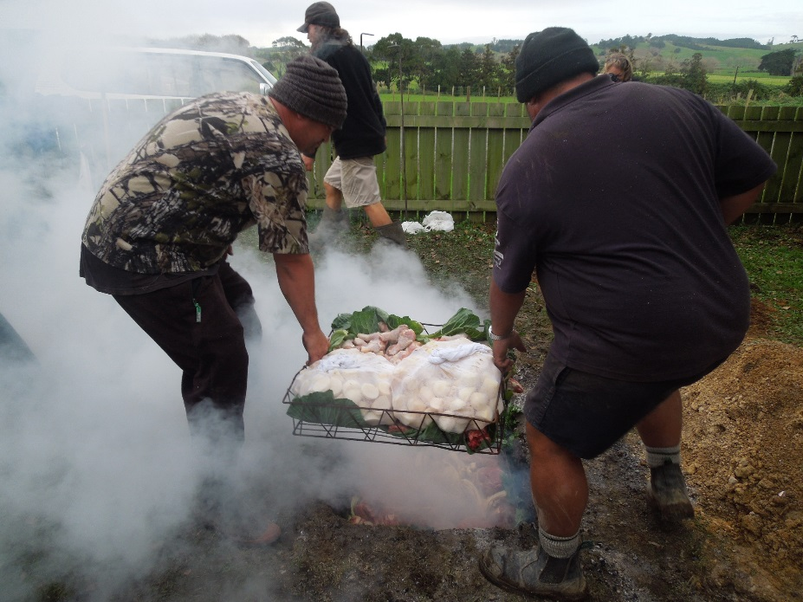
The Hangi
By Room 3
Tomarata School

Slide 2
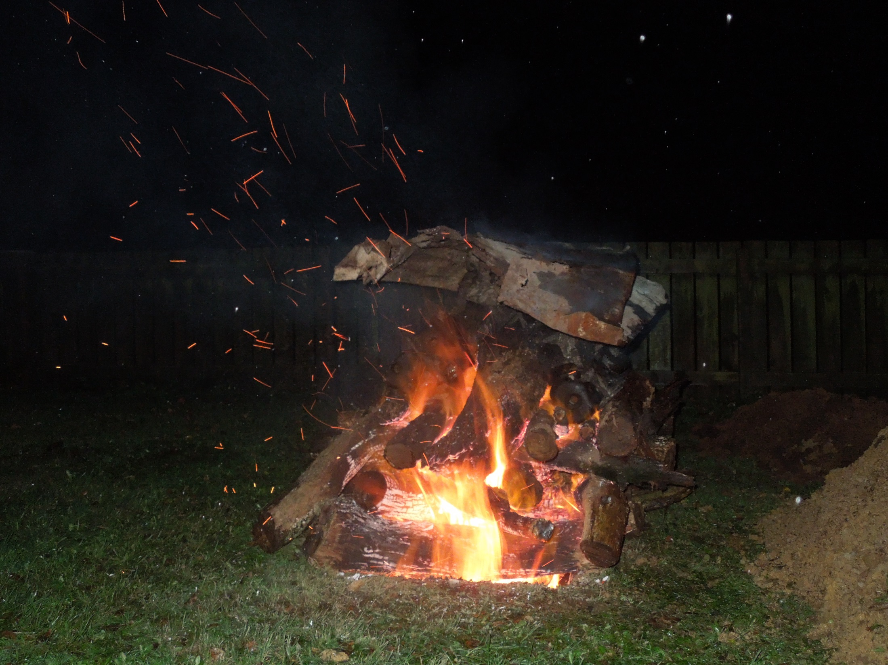
Early on Thursday Morning some men came to school and dug a large hole. Then they made a fire.

Slide 3
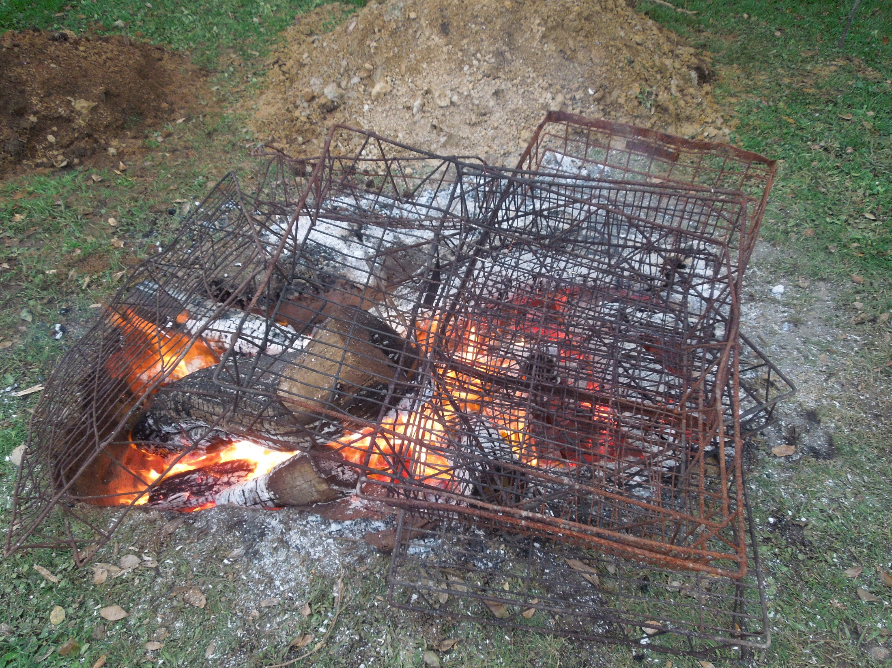
They got the metal baskets hot.

Slide 4
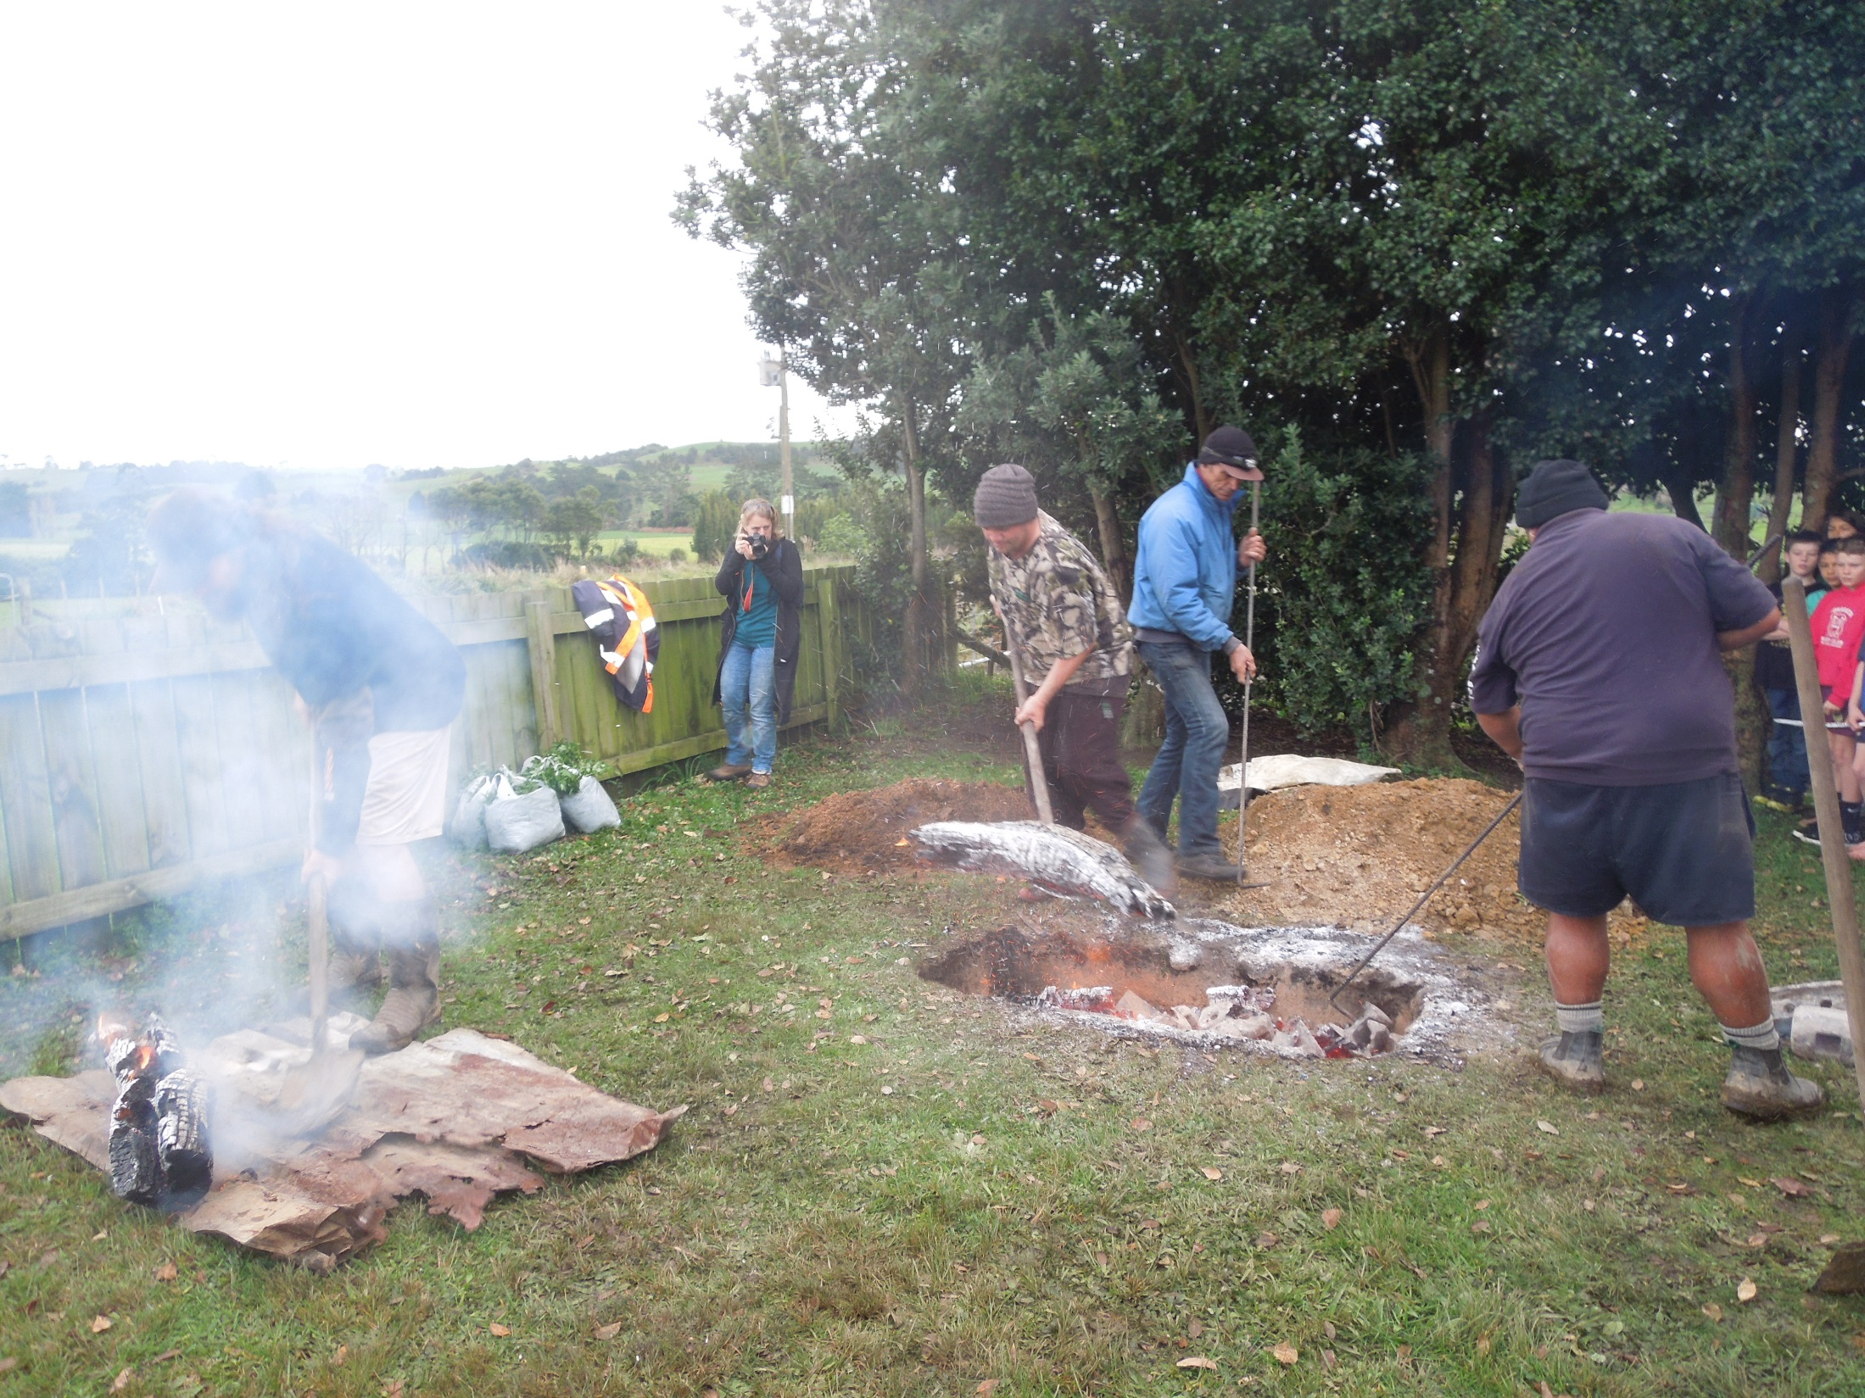
The school came to watch the Hangi being put in. They took everything out of the hole.

Slide 5
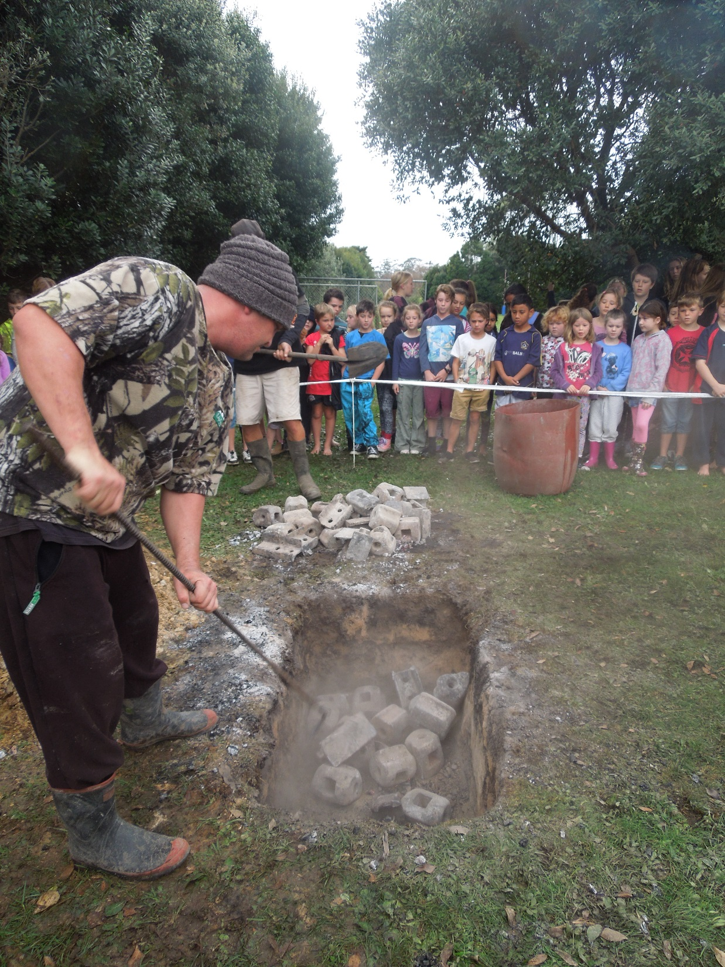
They put back the hot bricks.

Slide 6
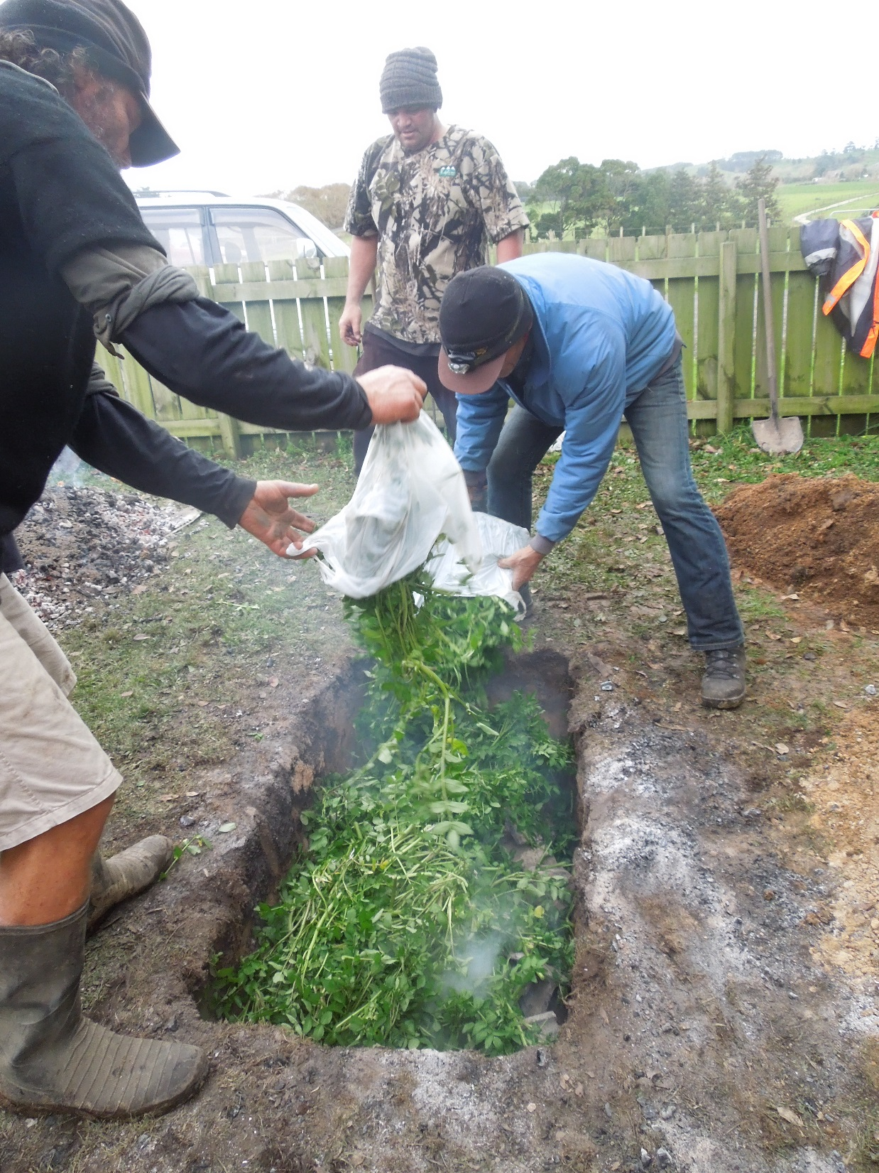
After that they put watercress on top of the bricks so that it didn’t burn the food.

Slide 7
The food was put on top. There was potato, kumera, pumpkin, chicken, beef, pork and mutton. Yum yum!

Slide 8
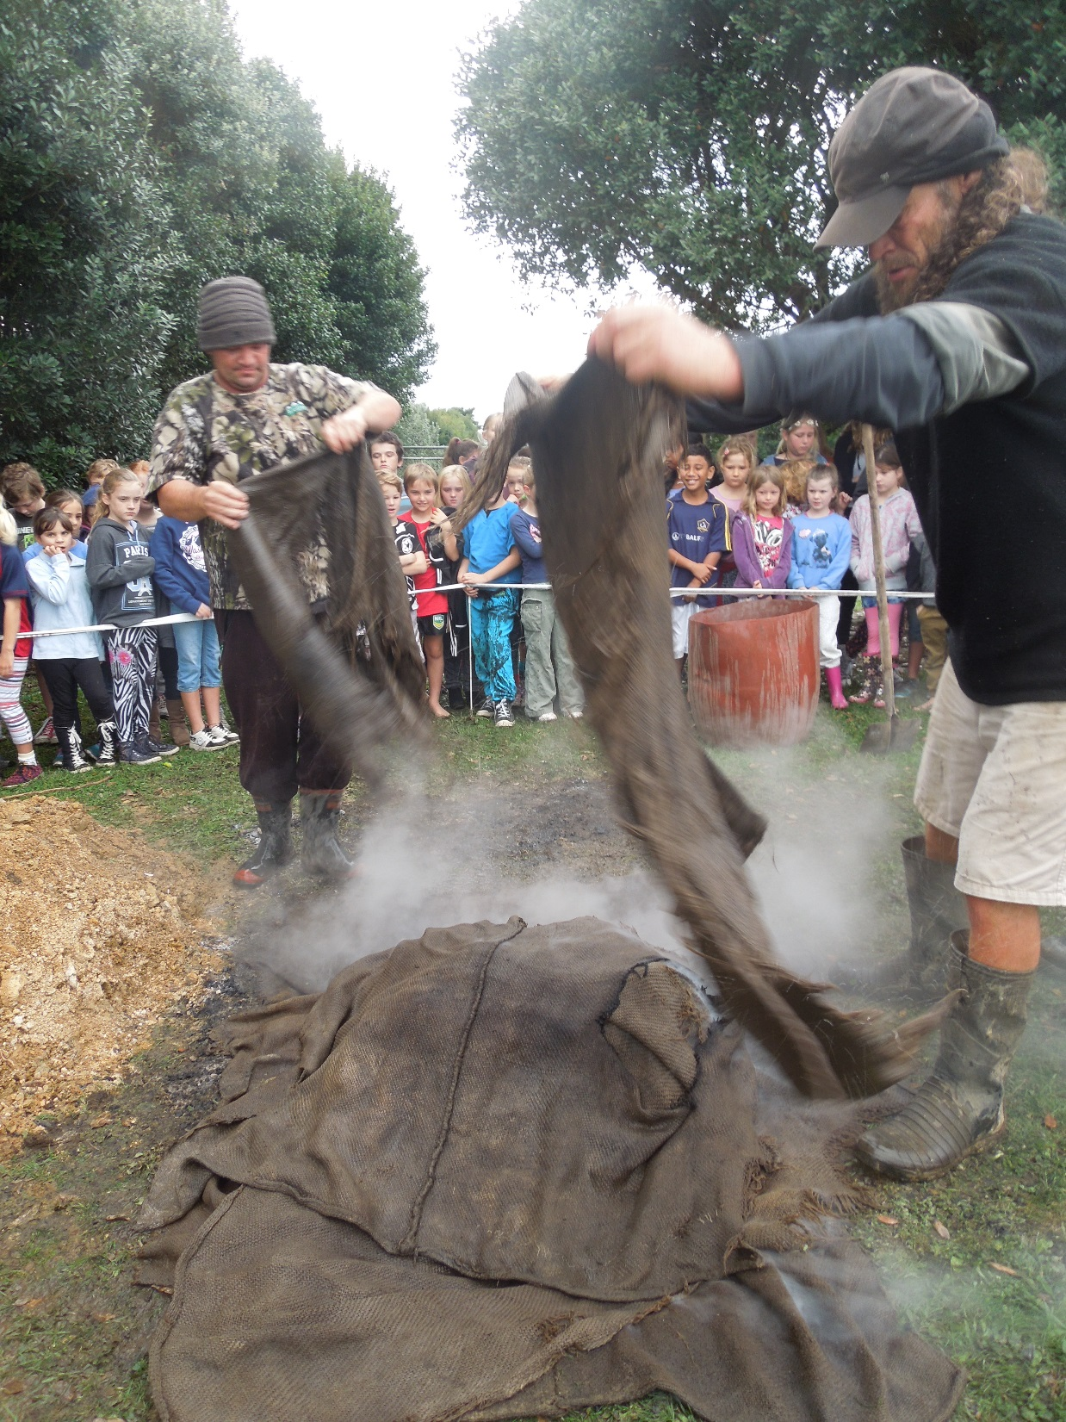
The men put wet sacks on the food. This creates steam.

Slide 9
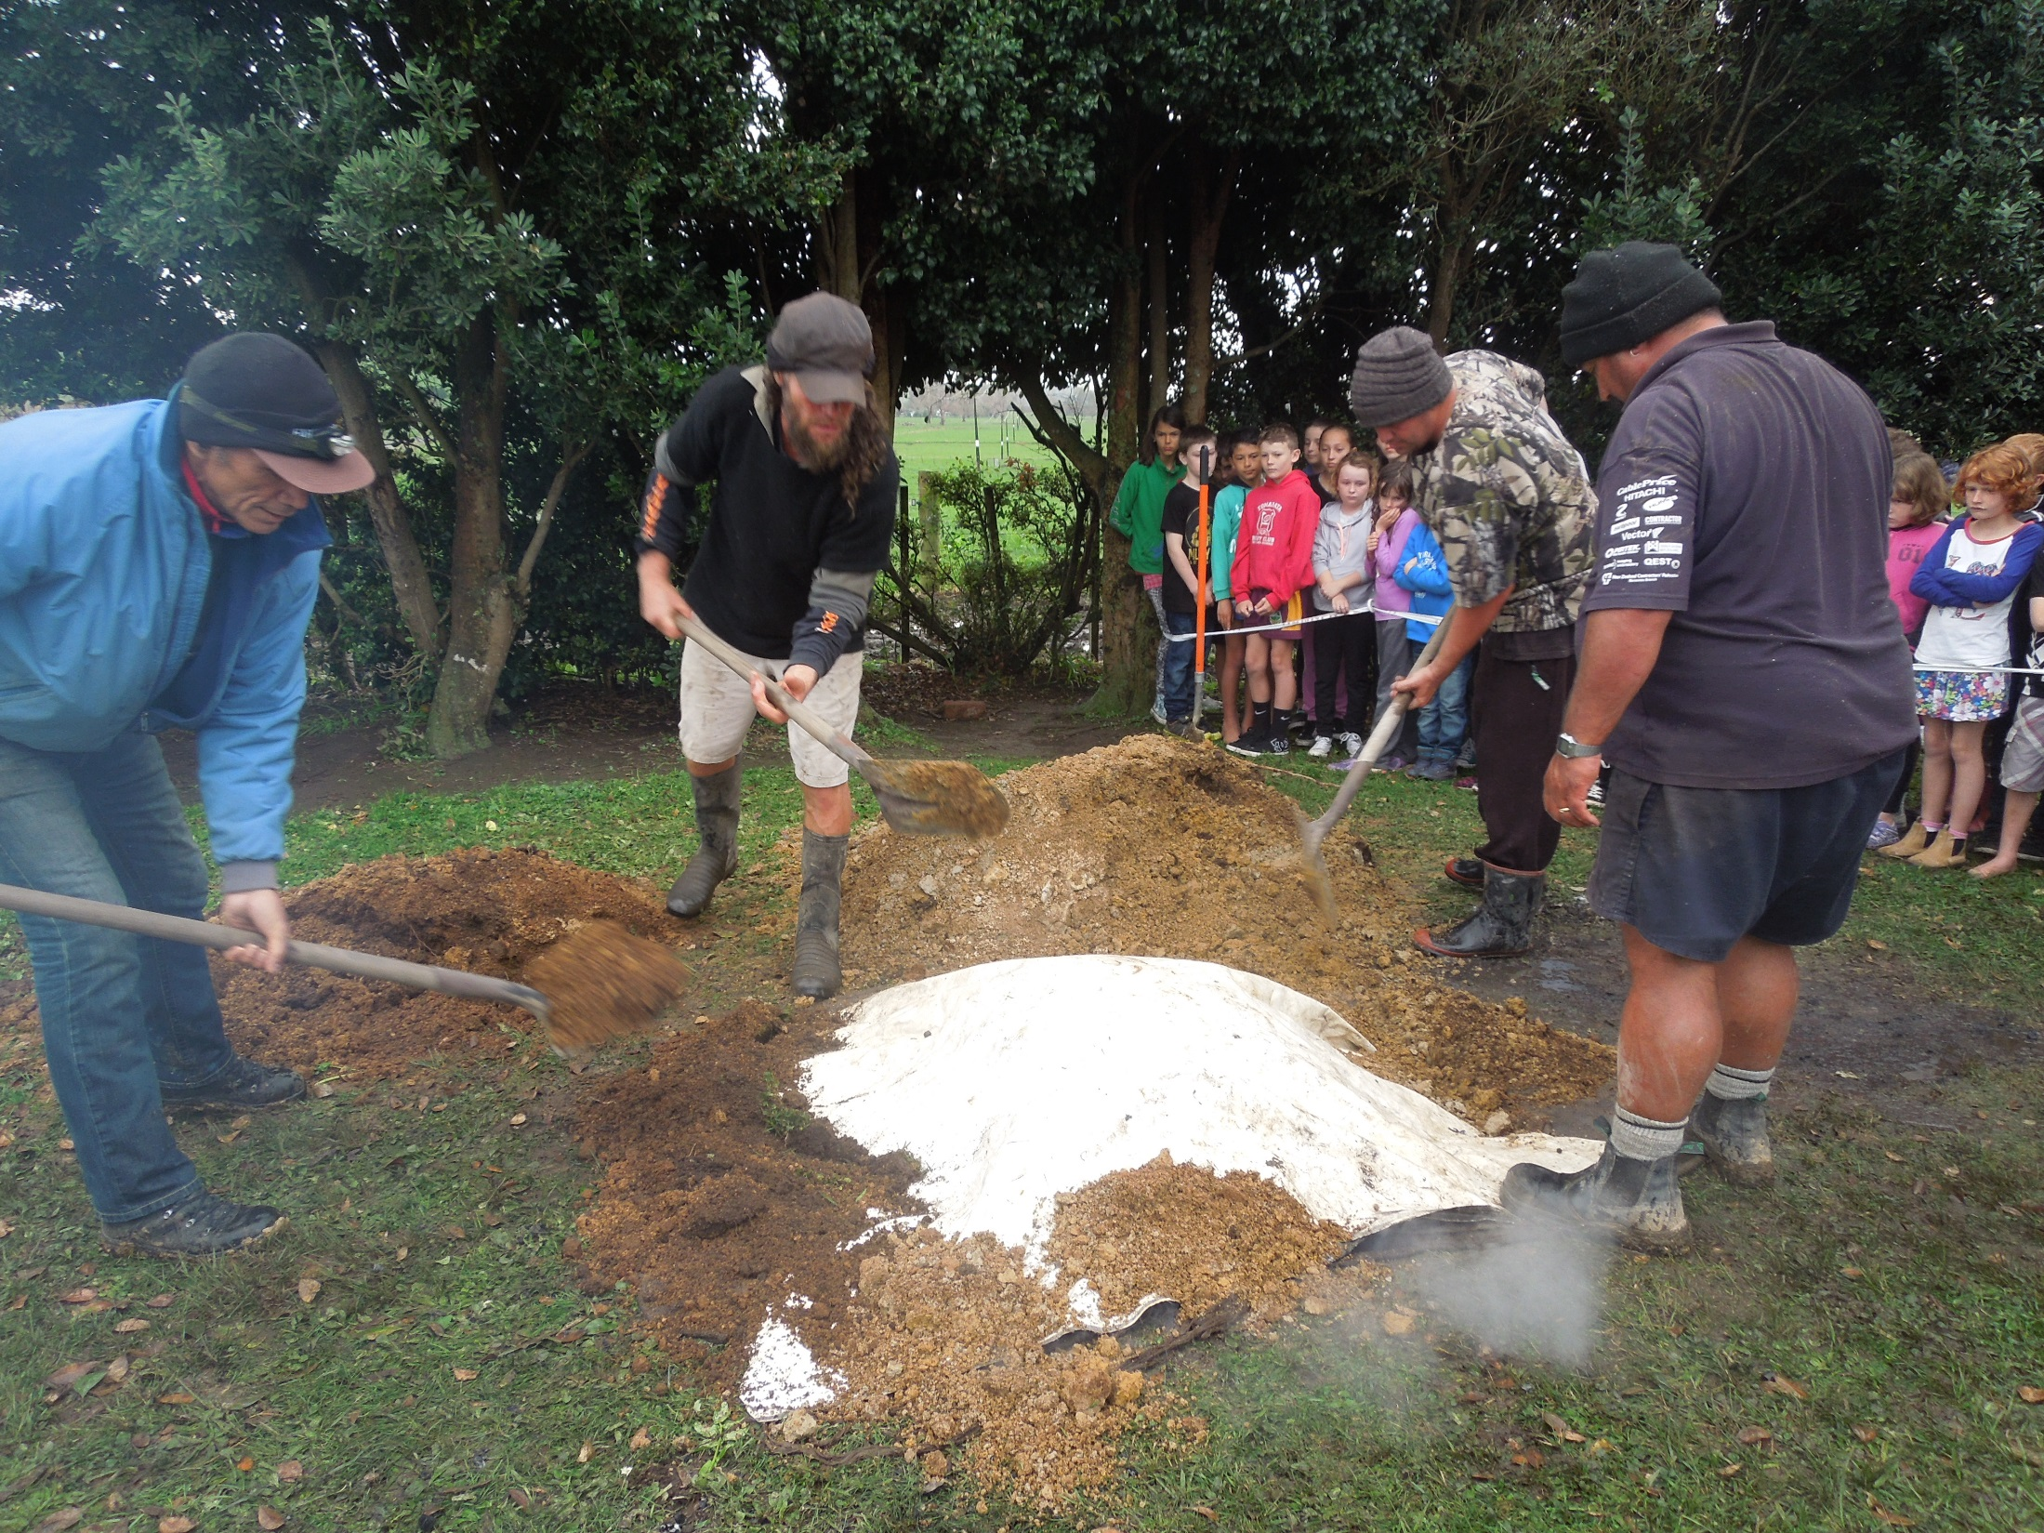
Then the men put on a white protective layer and shovelled the dirt on top.

Slide 10
We waited… and waited…
and waited…
Four hours later it was ready!

Slide 11
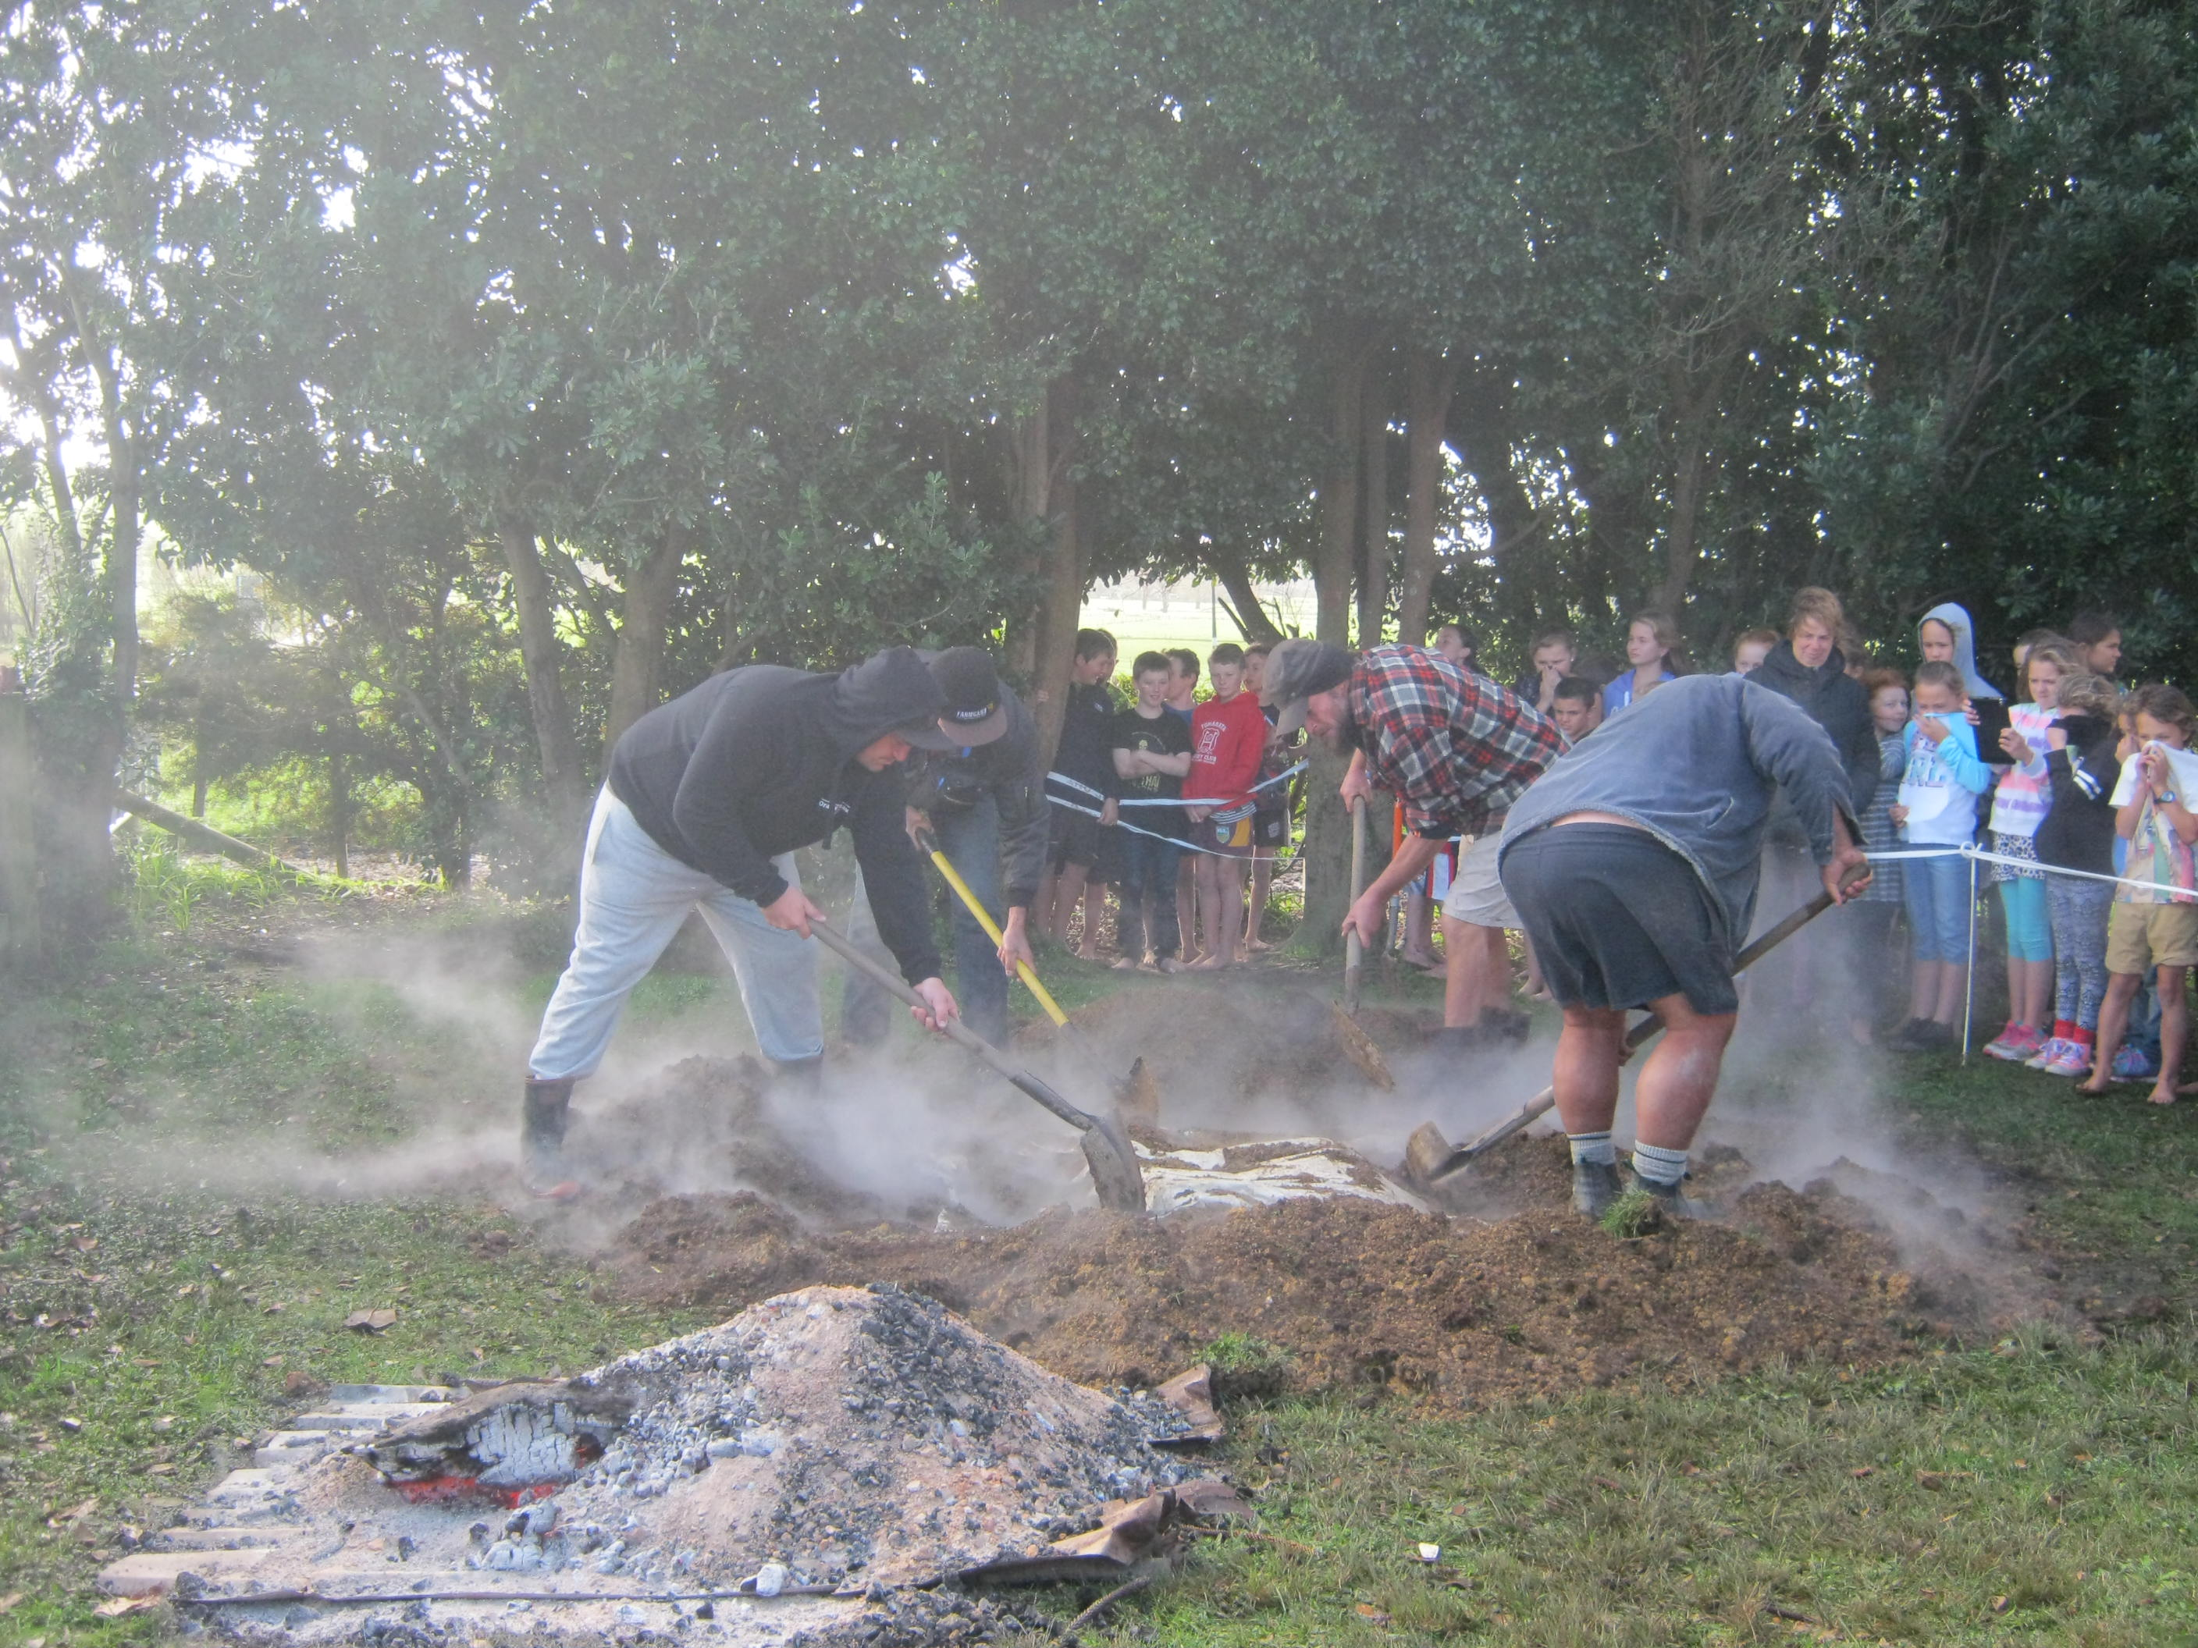
The men took all the dirt and sacks off the food.

Slide 12
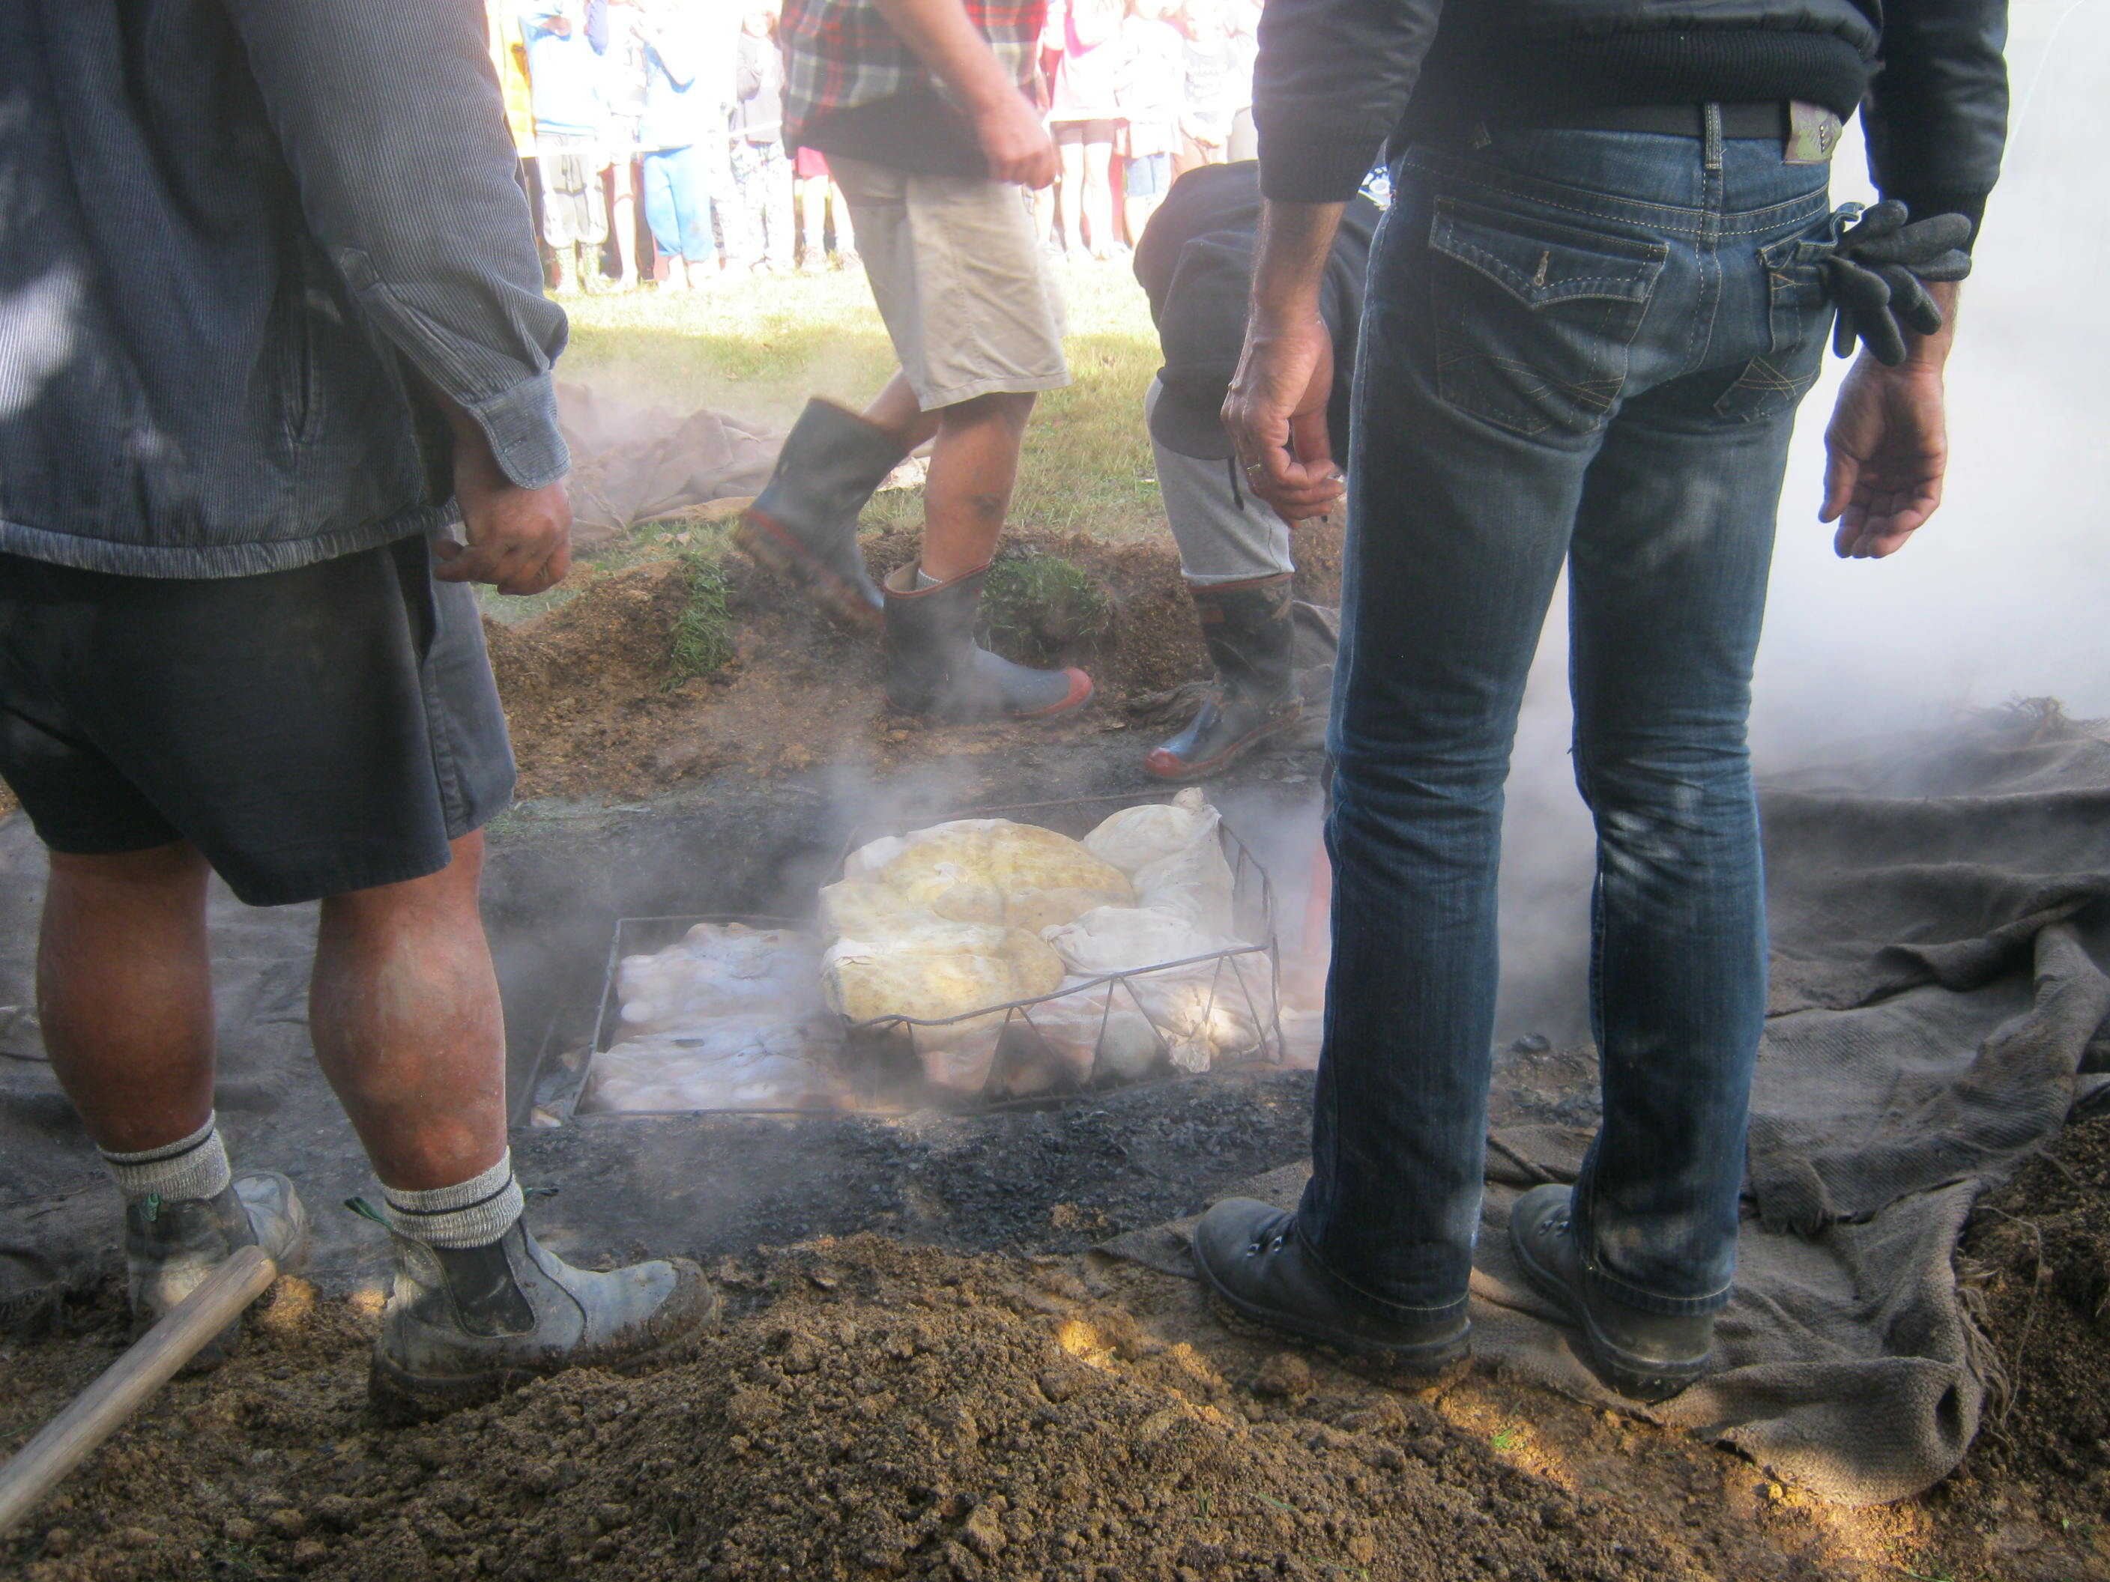
They took the food out. HOT HOT HOT!!!

Slide 13
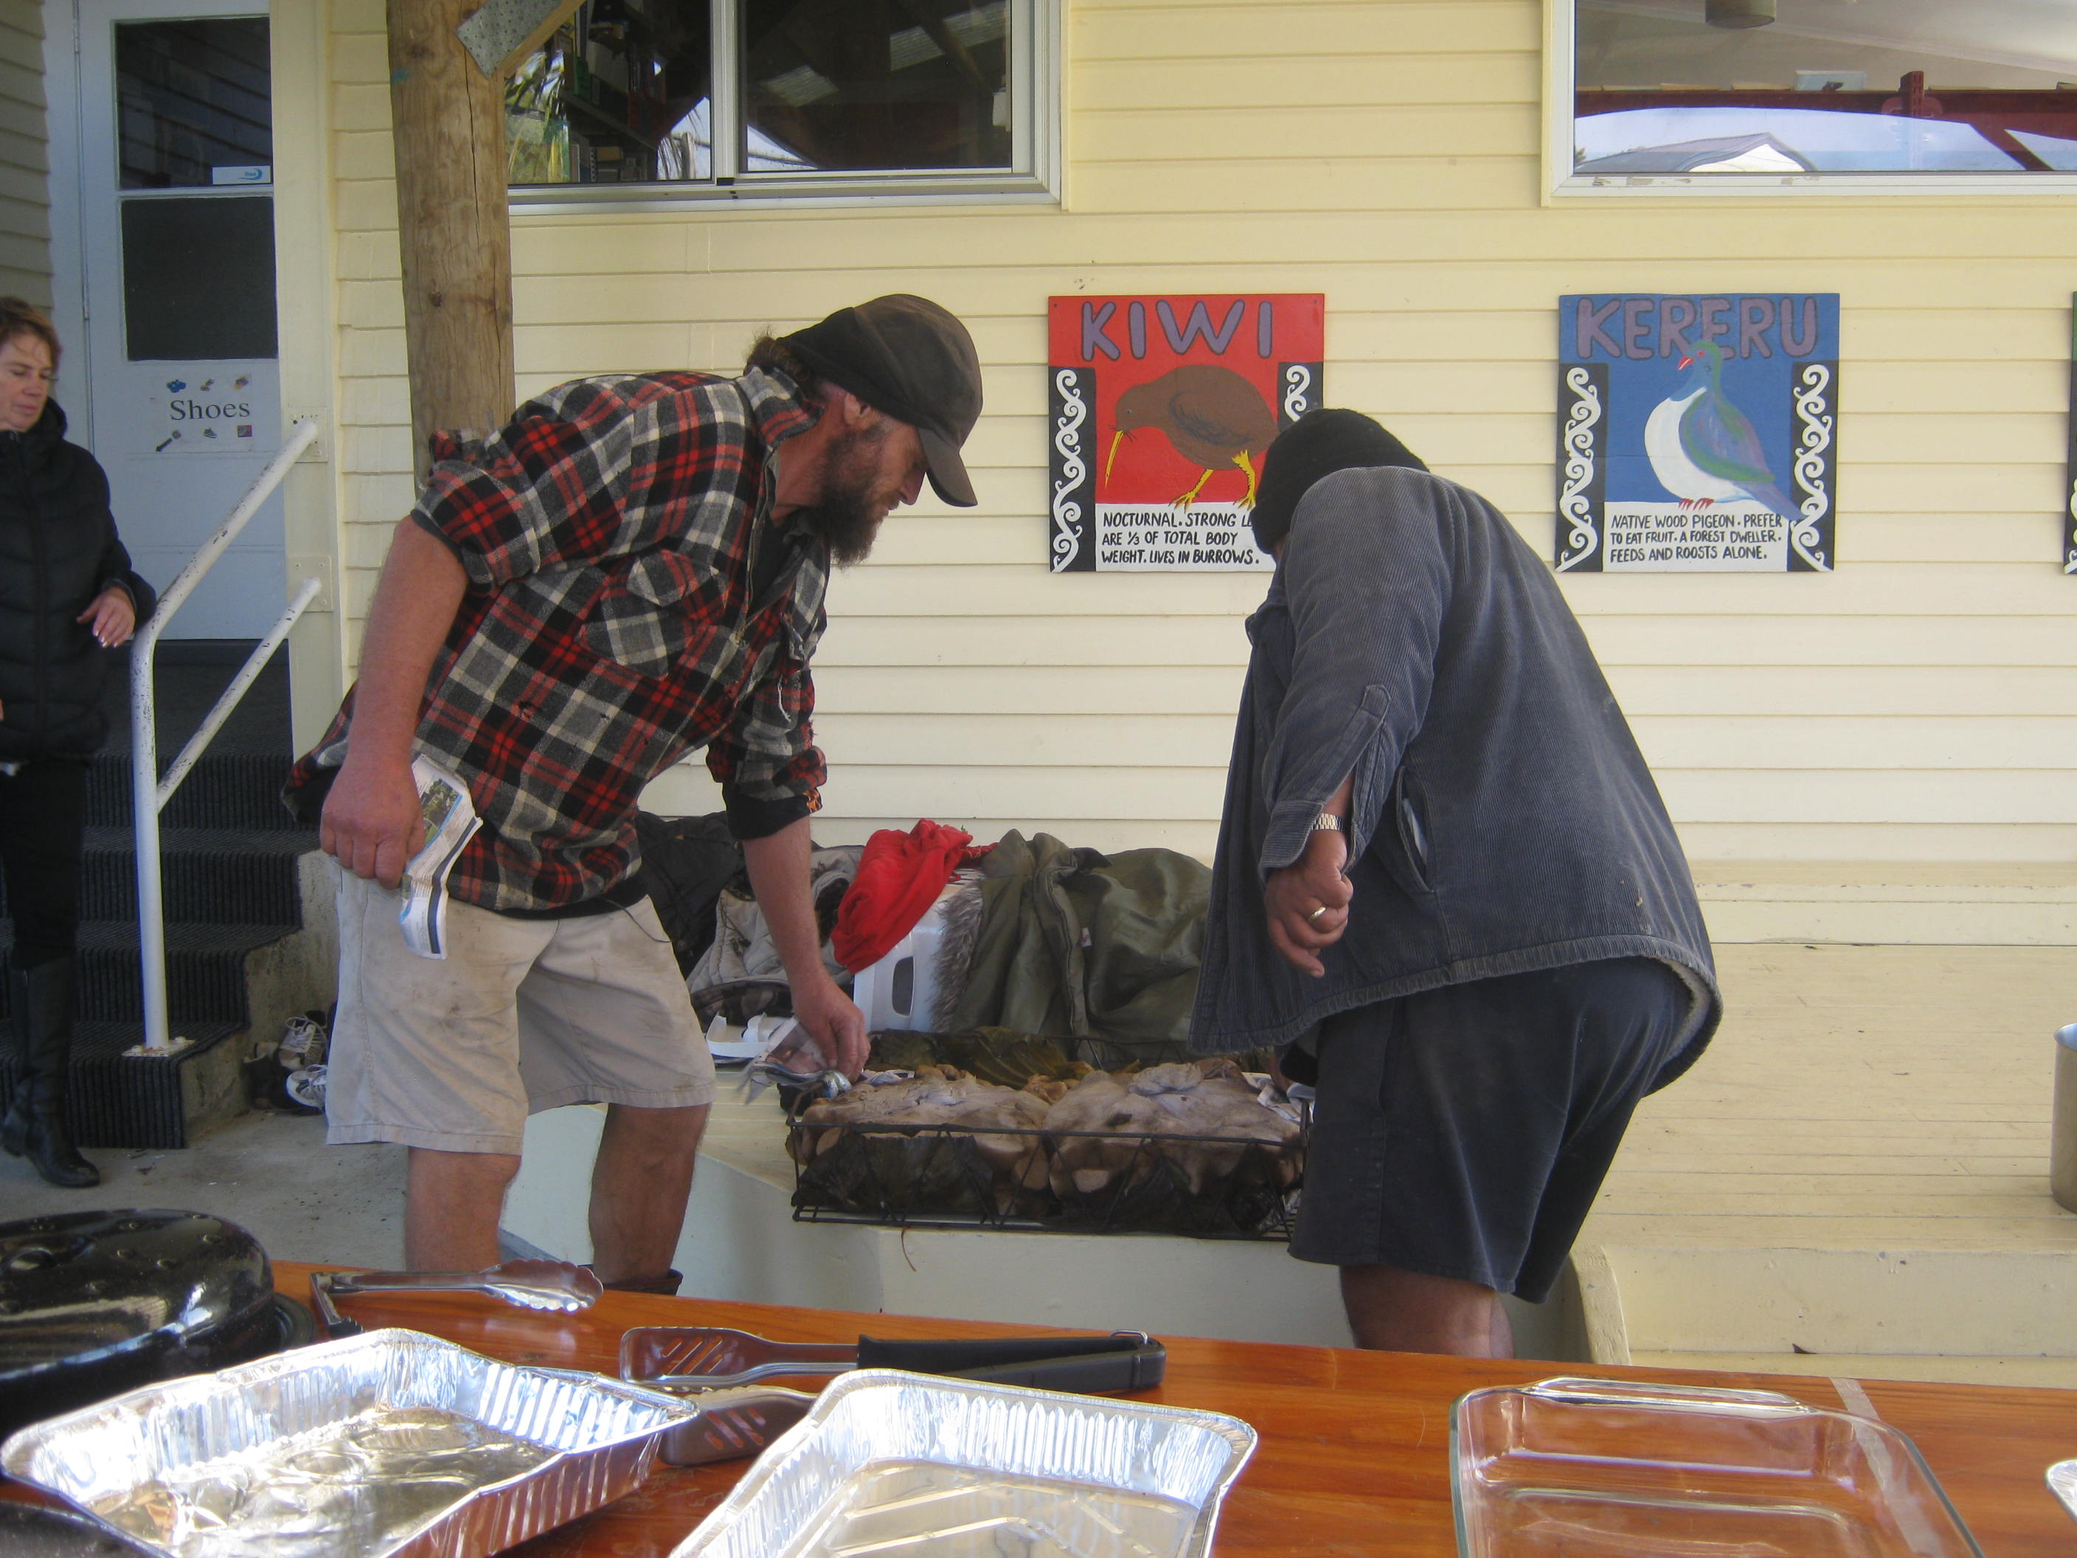
They brought it over to the covered area. We were hungry!!

Slide 14
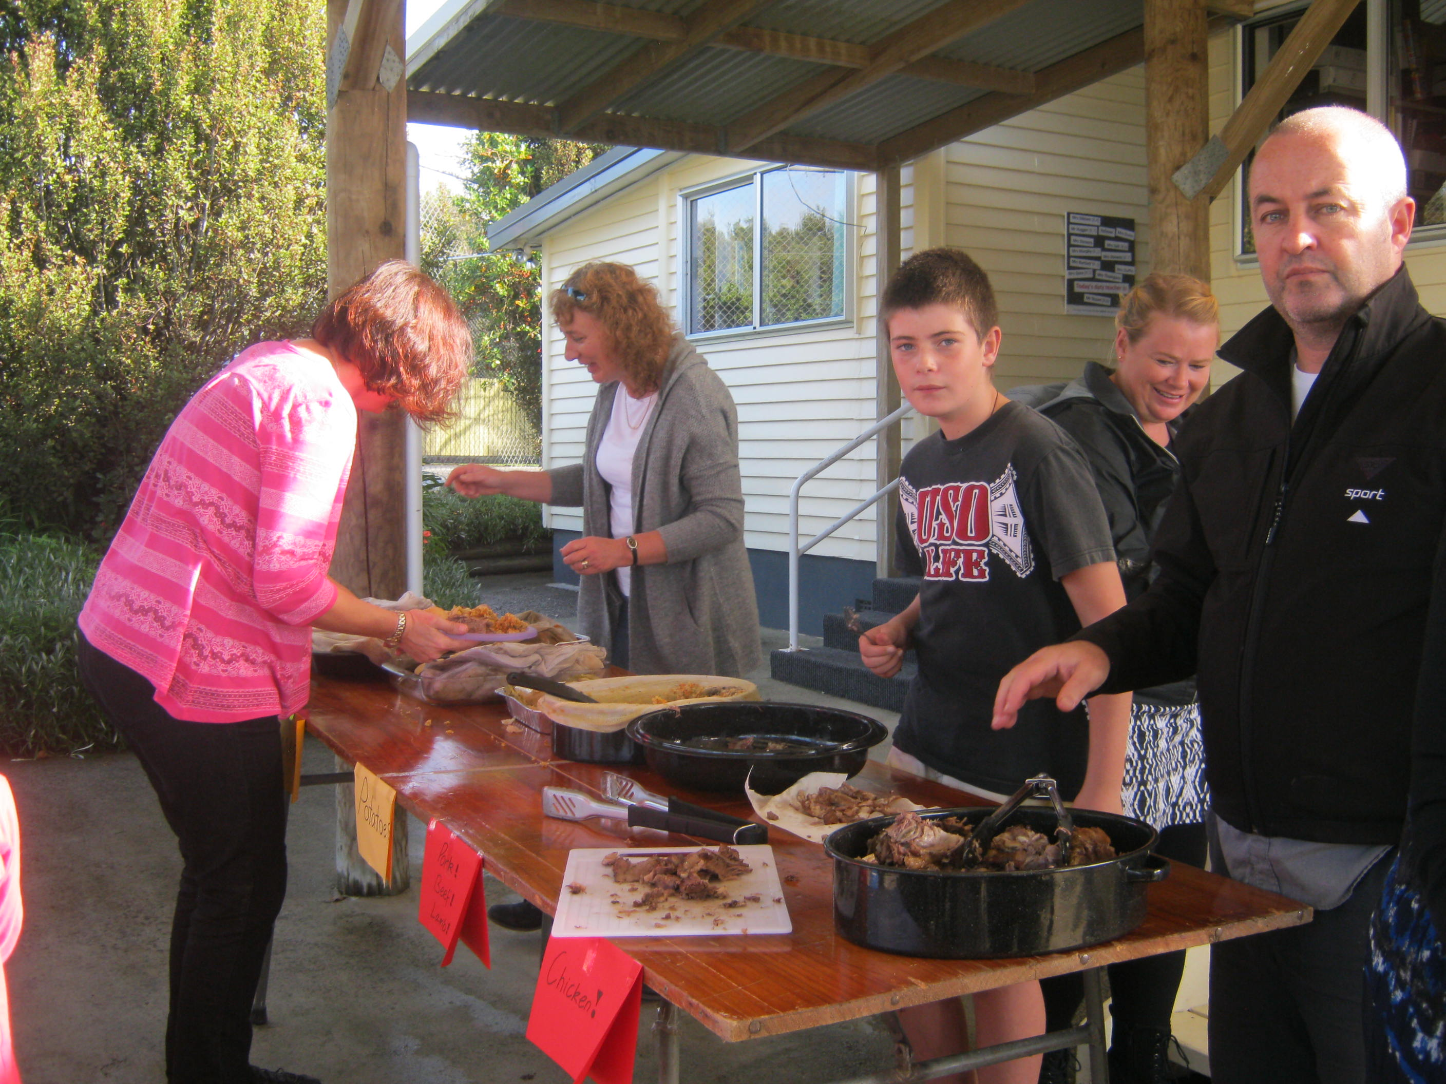
The food was put out onto tables.

Slide 15
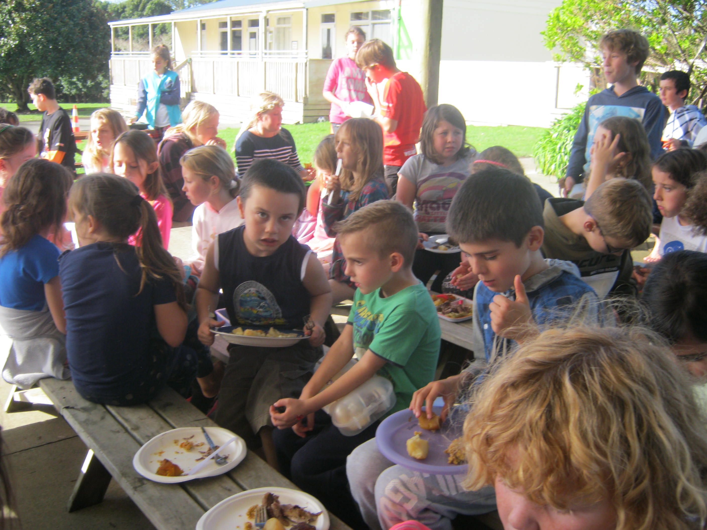
LUNCH TIME!!!!

Slide 16
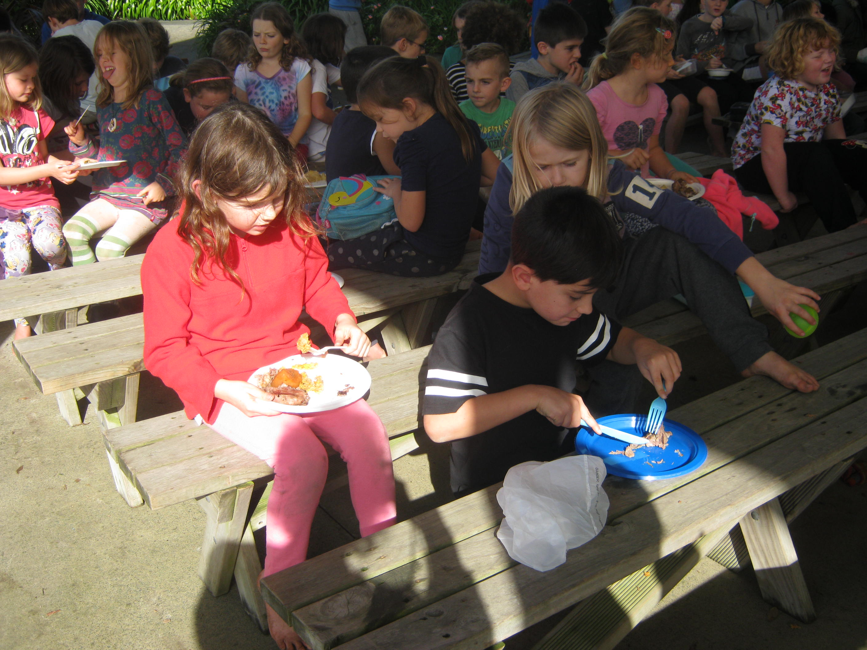
LUNCH TIME!!!!

Slide 17
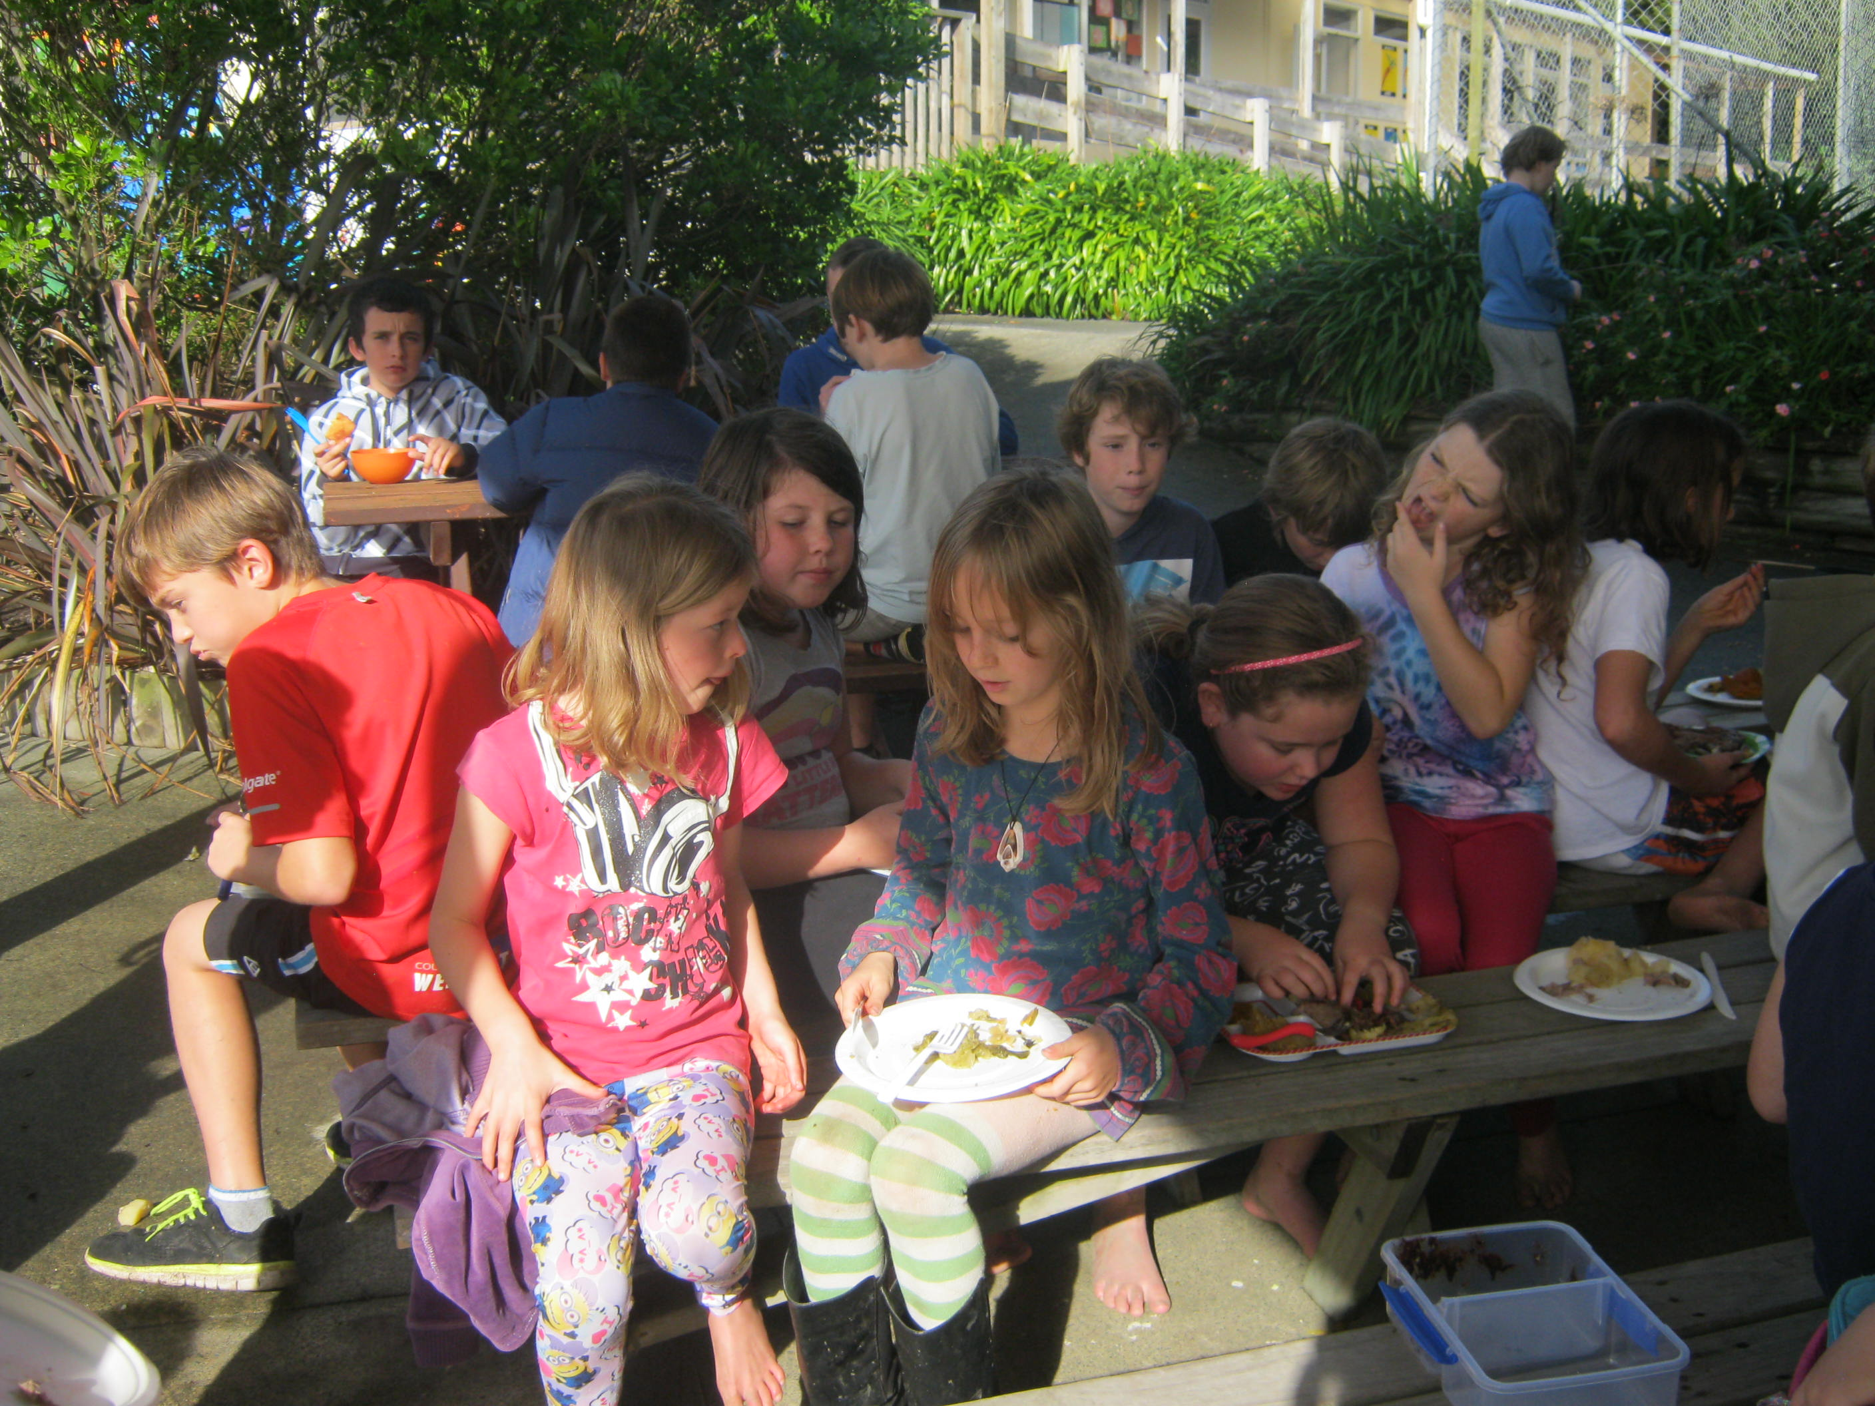
LUNCH TIME!!!!

Slide 18
What an awesome experience. Thanks teachers and helpers!!

